Slide 1

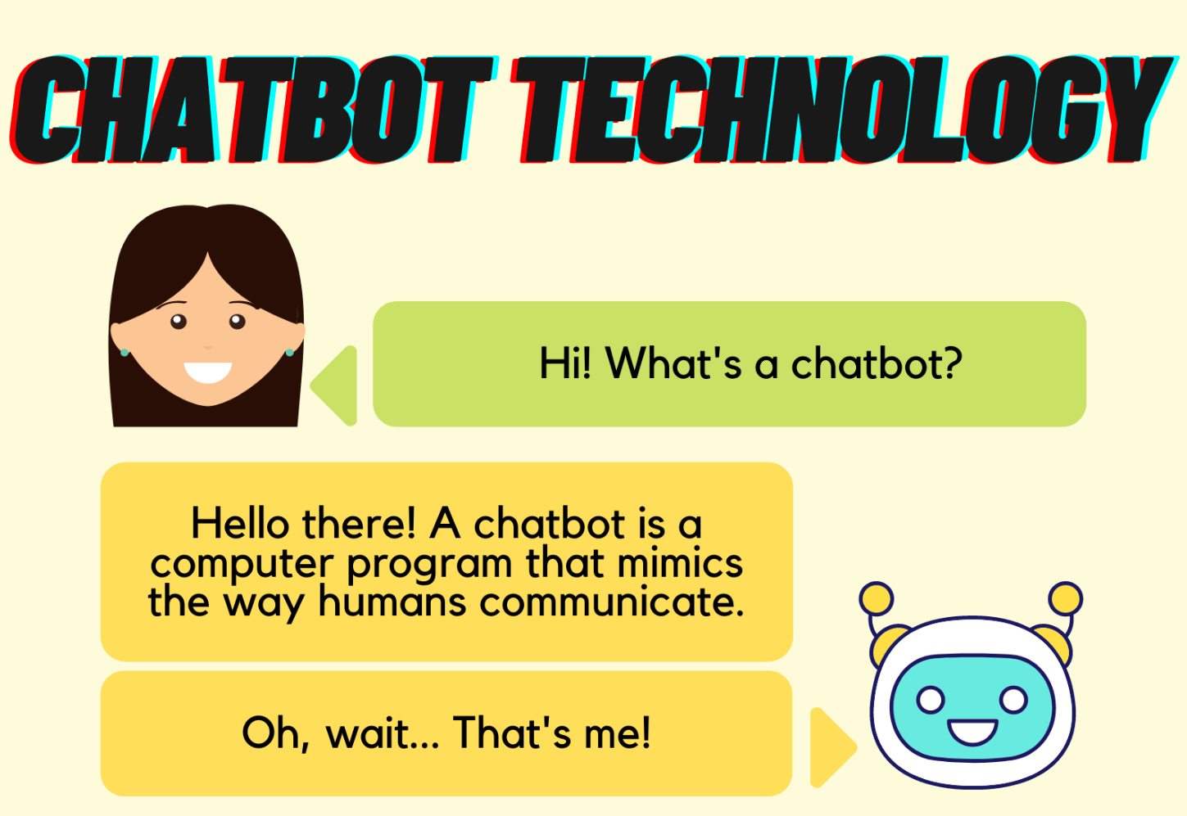
Title :
AI Chat-Bot
Name : P. David Raj
Id : 21071A7251
Dept of CSE – ( Cys, DS ) and AI&DS
College :
VNR Vignana Jyothi Institute of Engineering and Technology
Project Guide :
P. Vijayaragavan Asst Professor
Dept of CSE – ( Cys, DS ) and AI&DS

Slide 2

Abstract :
The AI Chat-Bot project is an intelligent conversational agent utilizing cutting-edge NLP techniques to deliver seamless and natural interactions. The focus is on enhancing user experience through real-time responses, assistance, and information retrieval. By understanding and processing user inputs, the chat-bot generates contextually relevant responses. The project aims to create a dynamic and user-friendly communication platform, showcasing the integration of advanced AI technologies.

Slide 3
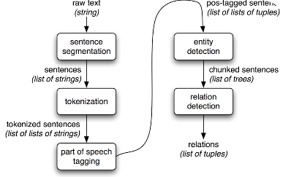
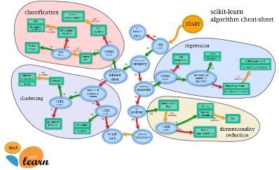

Methodology
NLP Implementation
Machine Learning Integration
Web Development Techniques
The methodology involves the implementation of a robust natural language processing (NLP) model to understand and interpret user queries effectively.
Machine learning algorithms are incorporated for continuous improvement and adaptation based on user interactions, enhancing the chat-bot's responses over time.
The chat-bot utilizes web development techniques to provide a personalized and intuitive interface, ensuring seamless interactions.

Slide 4
Technologies Used
Natural Language Processing (NLP)
Machine Learning
Employing machine learning algorithms for continuous improvement and adaptation based on user interactions, enhancing the chat-bot's effectiveness.
Utilizing advanced NLP models to comprehend and generate human-like responses, ensuring contextually relevant interactions.
Web Development (HTML, CSS, JavaScript)
Creating an intuitive and responsive user interface for seamless interactions, contributing to an immersive user experience.

Slide 5

Results
1
Interactive Conversations
The AI Chat-Bot project has demonstrated significant success in providing accurate and contextually relevant responses to user queries, leading to dynamic and engaging conversations.
2
Real-Time Updates
Real-time updates and personalized interactions contribute to a positive user experience, enhancing user engagement and satisfaction.
3
Continuous Learning
The chat-bot's ability to continuously learn and improve its responses based on user interactions enhances its effectiveness over time, ensuring reliable and informative conversations.

